Slide 1
British airways
Company inisights
December 4, 2022

Slide 2
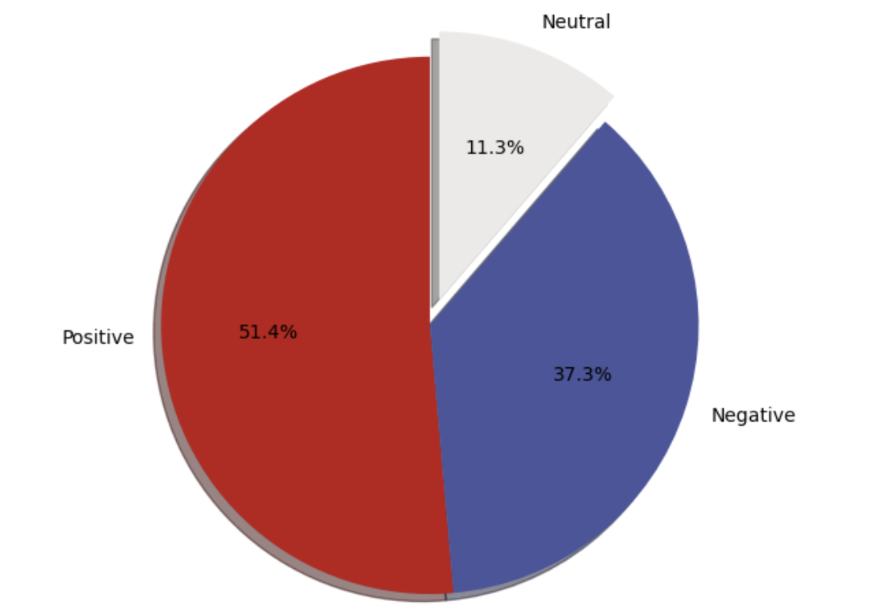
Company insights
51.4%
Positive Reviews
Customer reviews favourably mentioned:
Flight
Seat
Service
time
Link to Github Repository
Presented By: Carolina Zea (Link to Portfolio)

